Slide 1
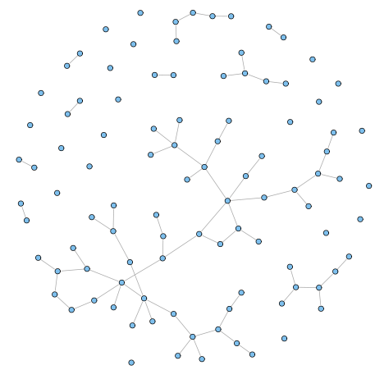



Herbivores in a Small World
Acoustic telemetry and network theory find herbivores display “small-world” dynamics
Presentation to 12th ICRS, Cairns
Rebecca Fox & David Bellwood
School of Marine and Tropical Biology, JCU
& ARC Centre of Excellence for Coral Reef Studies

Slide 2
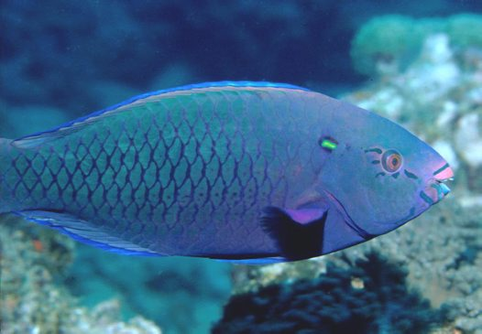
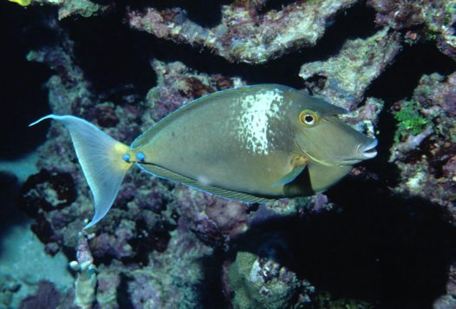
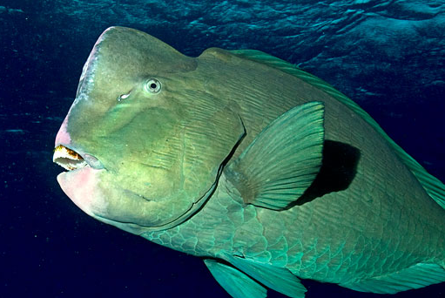
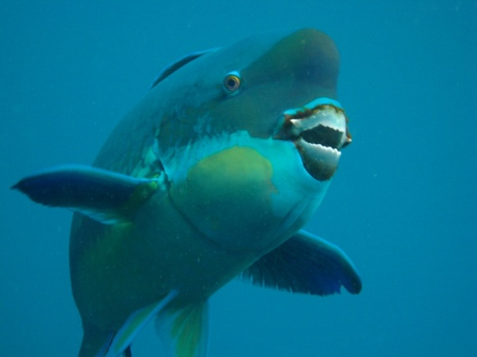
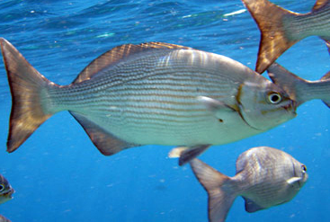
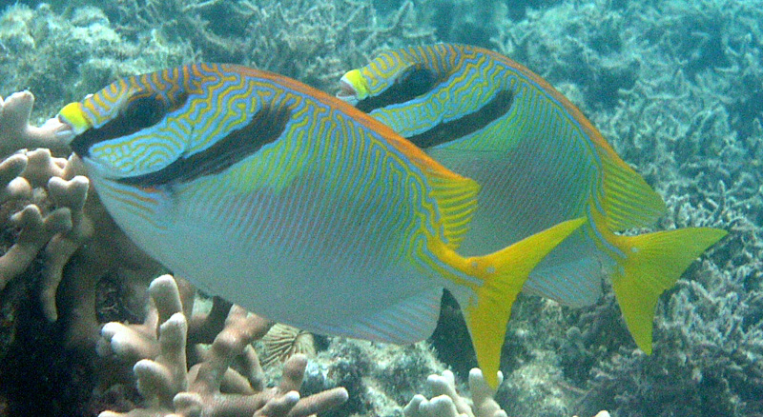
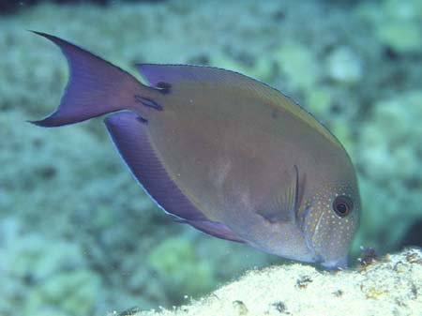
Background: Herbivore ecosystem function
Scrapers
(Bellwood & Choat 1990)
http://australianmuseum.net.au/Swarthy-Parrotfish-Scarus-niger/
http://australianmuseum.net.au/Bluespine-Unicornfish-Naso-unicornis/
Excavators
(Bellwood & Choat 1990)
http://randomriini.blogspot.com.au/2011/12/gili-air-day-3.html
http://www.dieter-kloessing.de/Malediven-
www.nautilus-scuba.net/gallery
Browsers
(Hoey & Bellwood 2009, 2010), (Bennett & Bellwood 2010), (Cvitanovic & Bellwood 2009)
Grazers
(Choat at al 2002)
(Fox et al 2009)
www.kininmonth.com.au
http://www.hawaiisfishes.com/fish_of_month/past_fom/fom_05_03.htm
Prevention
versus
Reversal
Bellwood et al. 2006

Slide 3
Background: Study aims
Ecosystem function
= f(what you do, where you do it)
Aim: investigate the long-term spatial ecology of roving herbivorous fishes
1. What level of site fidelity?
2. What degree of mobility?
3. How roving is ‘roving’?

Slide 4
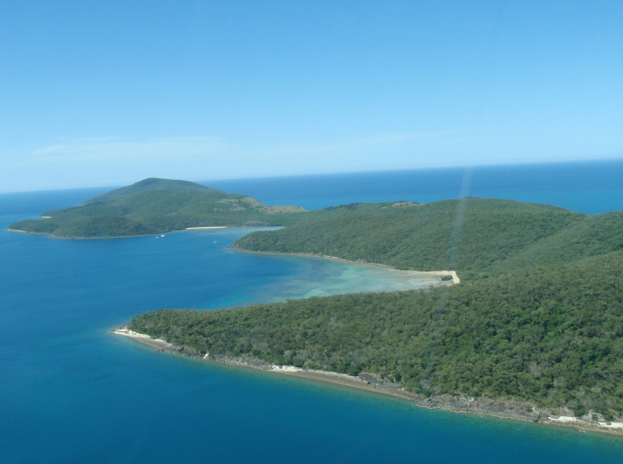

Slide 5
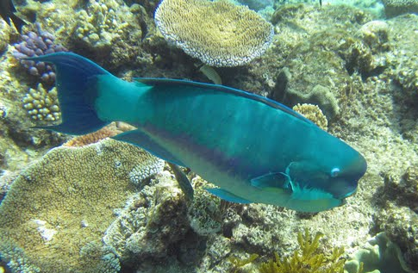
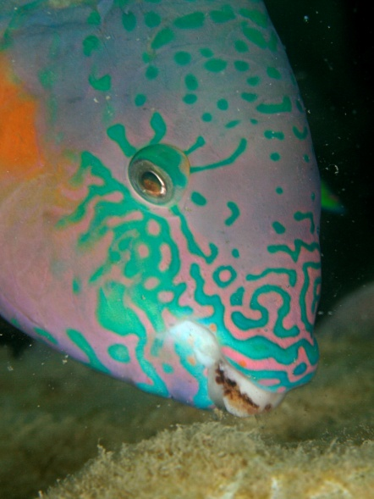
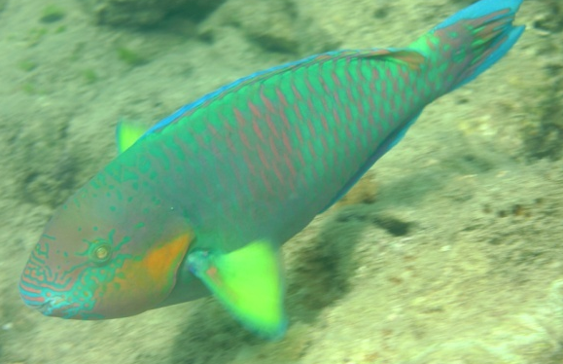
Herbivores at Orpheus Island
Chlorurus microrhinos
Siganus doliatus
www.nautilus-scuba.net/gallery
www.panoramio.com
www.kininmonth.com.au
Scarus rivulatus
>90 % of roving herbivore biomass on reef crest
Fox RJ & Bellwood DR (2007) Mar. Ecol. Prog. Ser. 339: 49-59.
Photo: JP Krajewski
Photo: JP Krajewski

Slide 6
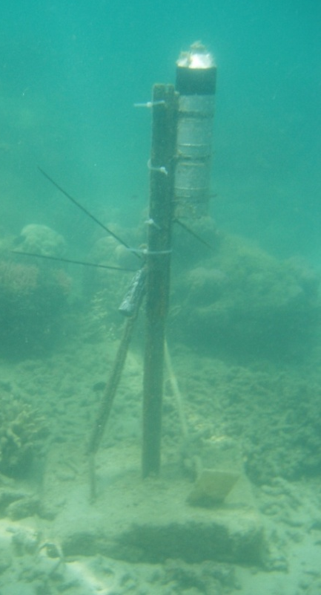

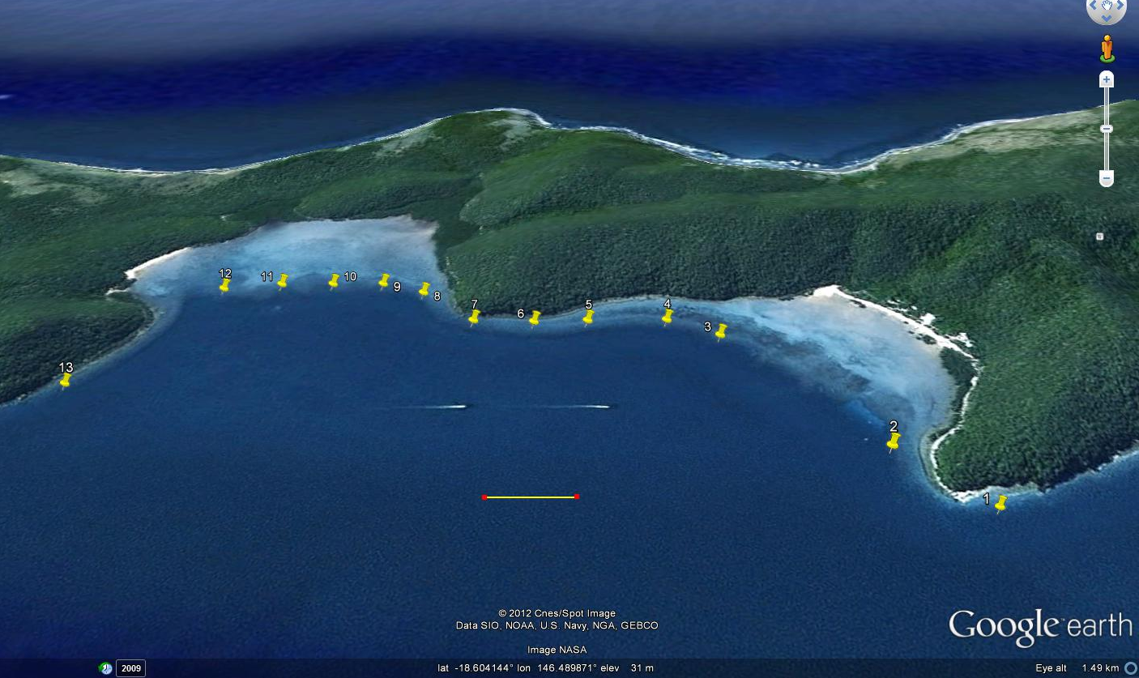
Acoustic Array
200 m

Slide 7
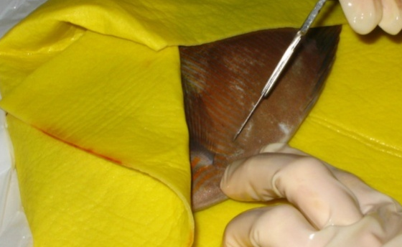
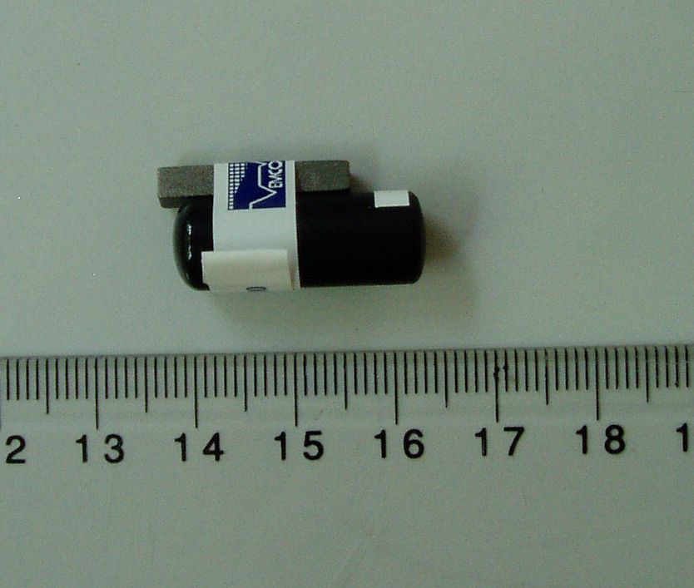
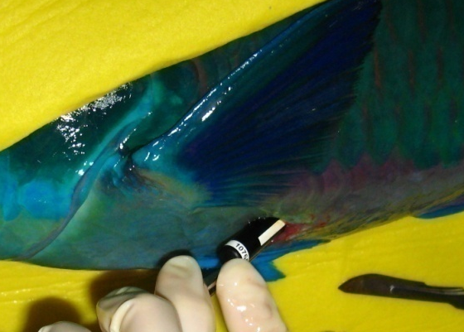
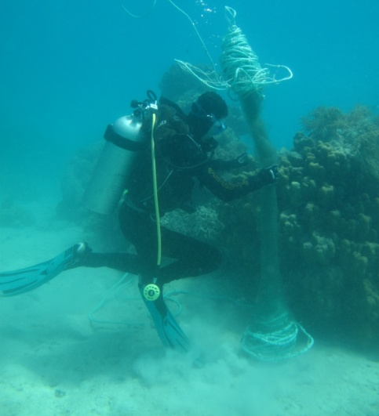
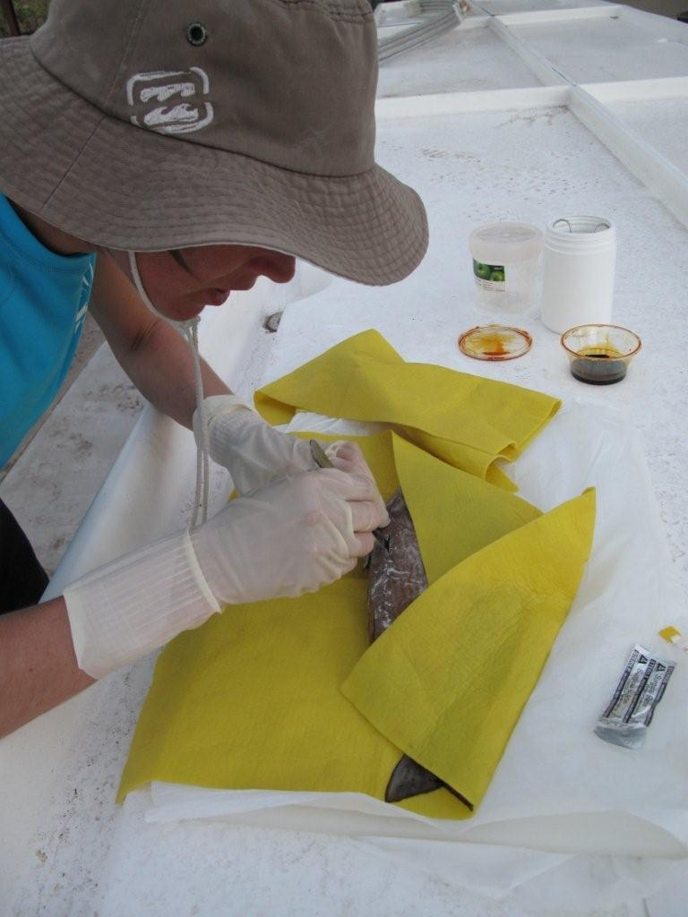
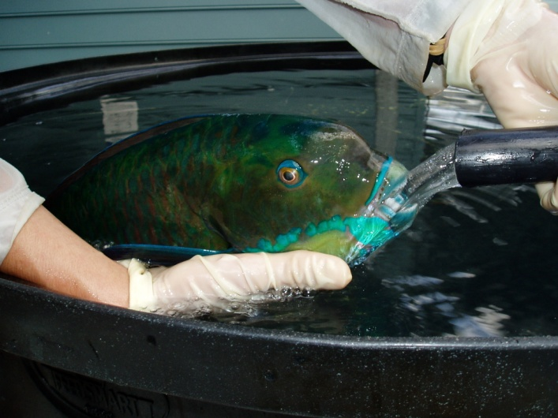
Methods
  20 individuals tagged
  (4 x C.microrhinos, 6 x Sc.rivulatus, 10 x S.doliatus)
  23mm x 9mm transmitter inserted internally under anaesthesia
  (Vemco V9-1L, 60s/ 90s period, 157/ 226d battery life)
  Overnight recovery then released
  Data downloaded every 8 weeks

Slide 8
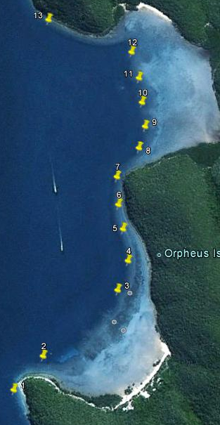
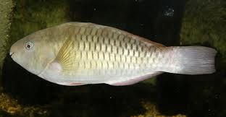
Results – Presence time stamps
~360m
8 months

Slide 9
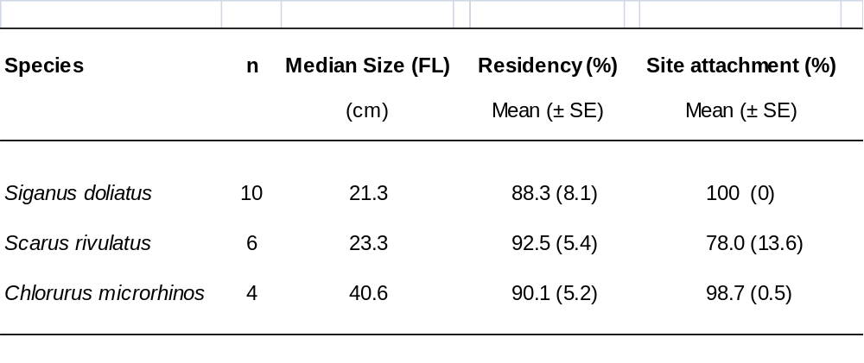
Results – Residency & site attachment
High residency levels
Strong local site attachment

Slide 10
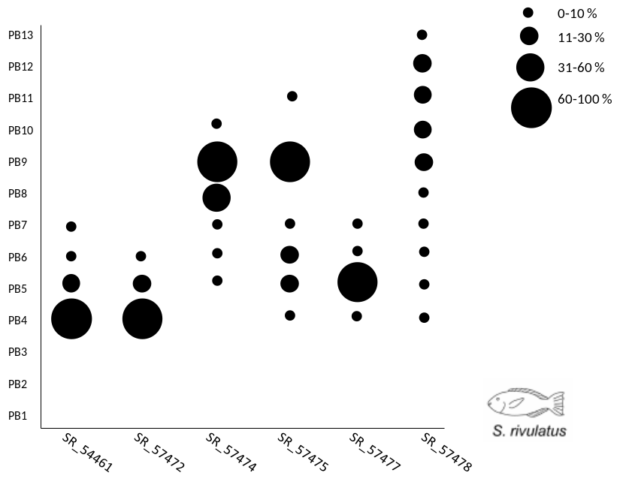
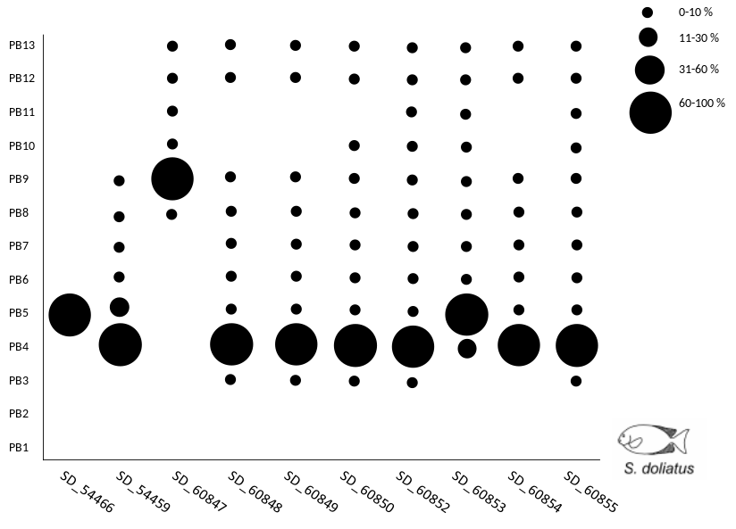
Results – Detection frequencies
Linear spatial impact
(based on 90% diurnal detections)
S. doliatus: 152m ± 21
C. microrhinos: 200m ± 46
Sc. rivulatus (IP): 280m ± 20
Sc. rivulatus (TP): 520m ± 158
Static picture
What about the dynamics?
www.kininmonth.com.au

Slide 11
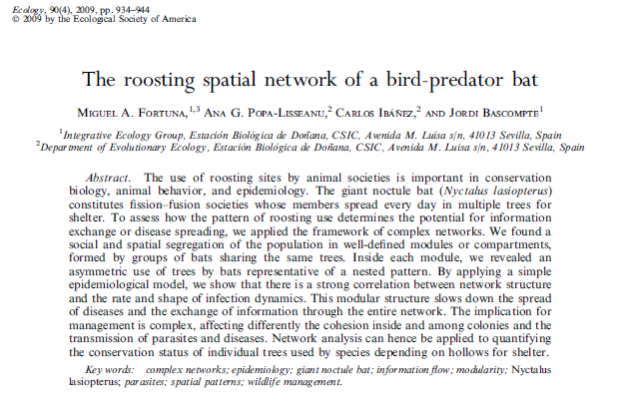
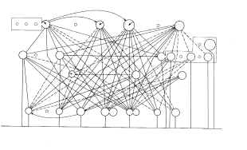
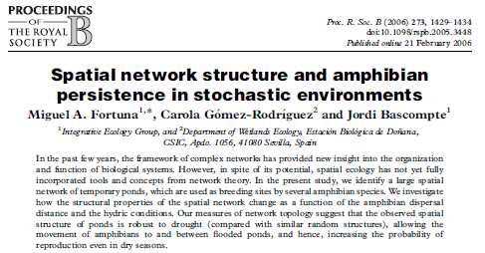
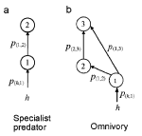
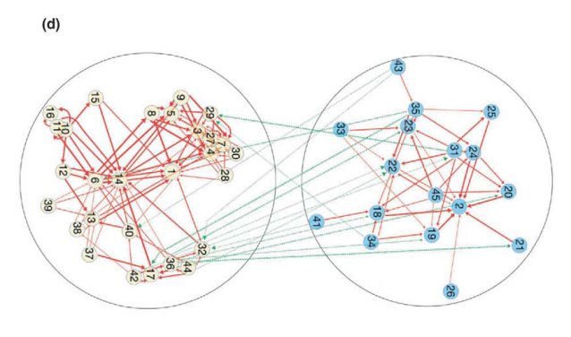
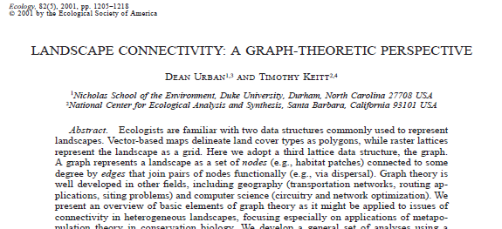
Background – Use of Networks in Ecology
Species-to-species interactions
eg. food-webs
Application to spatial ecology lagged behind
Most existing spatial applications focus on terrestrial systems
Warren (1989) Oikos
Pillai et al (2010) Theor Ecol
Krause et al (2003) Nature

Slide 12
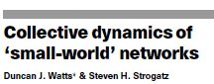
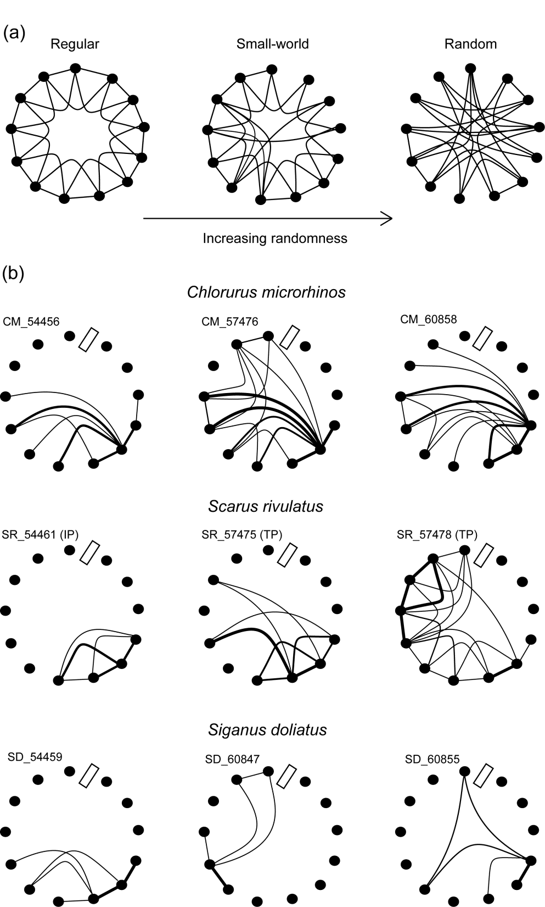
Background – Network Theory
Node
Edge
Watts & Strogatz (1998) Nature 393: 440-442

Slide 13
Herbivore dynamics
200 m
Photo: JP Krajewski

Slide 14
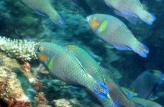
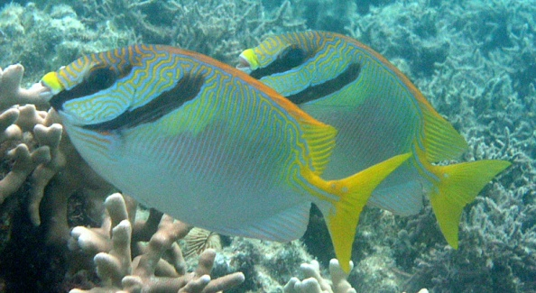
Results - Network graphs
www.panoramio.com
Directed movements between reef areas
Consistent paths
“Hub and spoke” pattern of reef utilisation
www.fishbase.org
www.kininmonth.com.au

Slide 15
Network metrics
Regular Network
Random
Network
Characteristic path length (L)
(Average number of edges in the shortest path between two nodes)
Degree of clustering (C)
(Fraction of all potential edges between neighbouring nodes that actually exist)
High
path length
Low
path length
High clustering
Low clustering

Slide 16
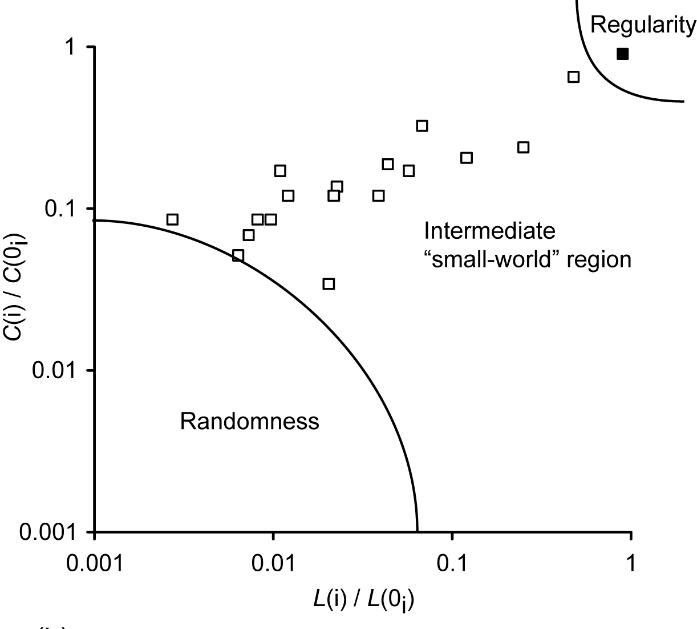
Results – Network Analysis
  Herbivore networks fall into
  realm of “small-world”
  Vulnerable to targeted attack
  eg. fishing effort
  Provides mechanistic explanation for vulnerability
  to fishing pressure (Graham
  et al. 2011, Ecol Lett)

Slide 17
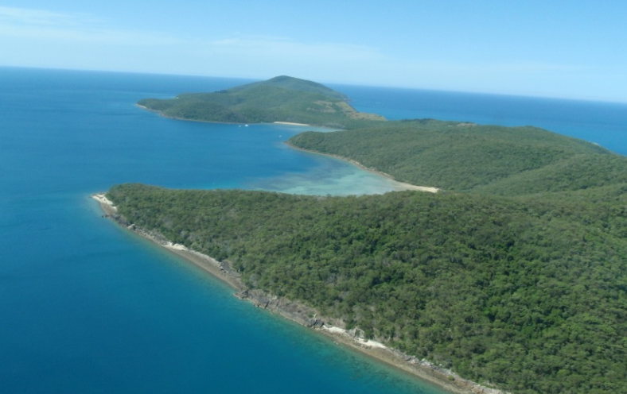
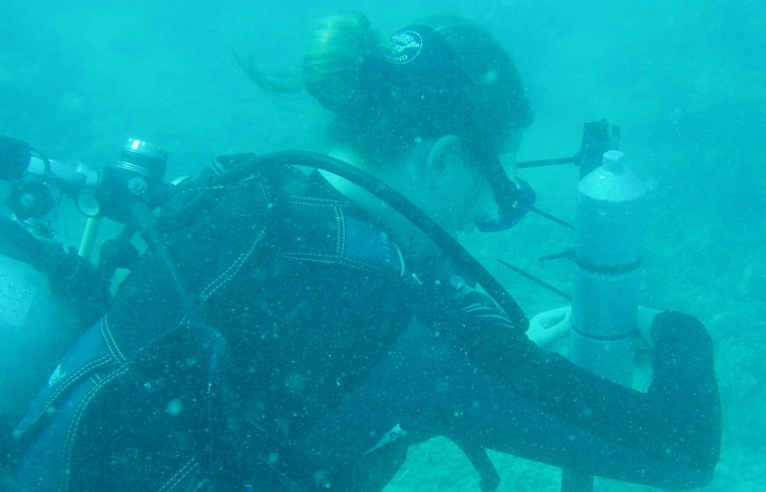
Summary
Limited spatial impact of “roving” herbivores
High site fidelity and local site attachment
Non-random movement patterns
Fixed patterns of reef usage from “hub”
Small-worlds
Exception, male S. rivulatus

Slide 18
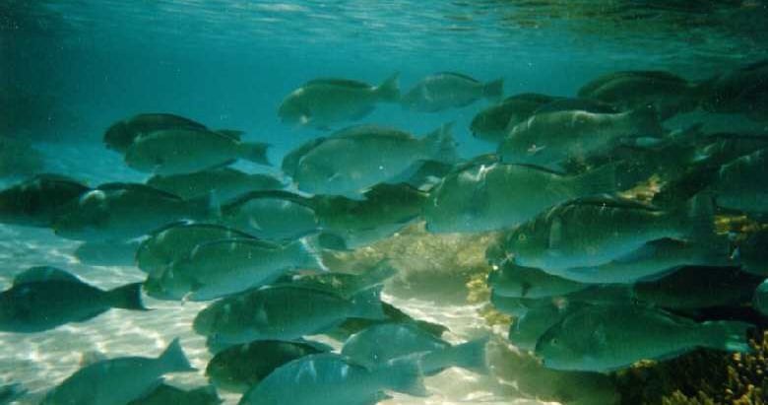
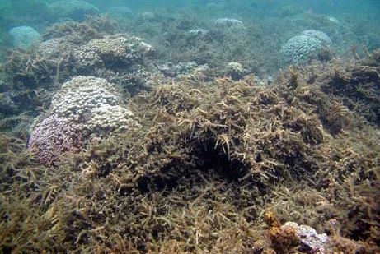
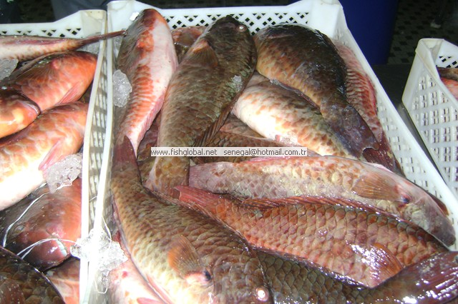
Conclusions
Fewer mobile links than thought
Good news:robust to random disturbances
Bad news: vulnerable to targeted attack
Maintain herbivore abundances
Network theory a useful tool for building dynamic picture of fish movements
http://freshseafoodexporter.com/2011/12/07/frozen-parrot-fish/

Slide 19



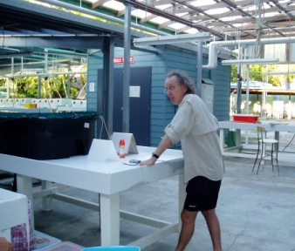
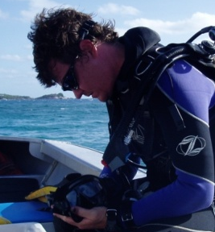
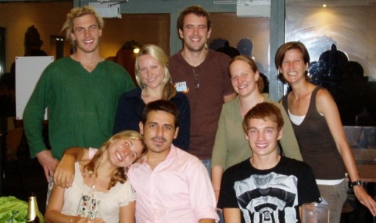
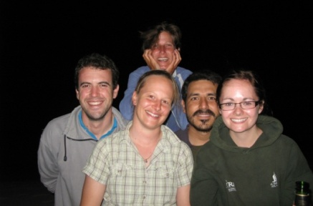
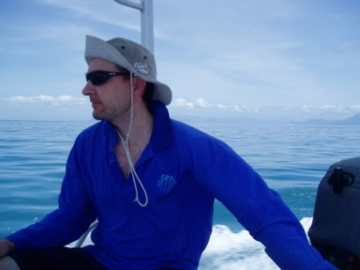
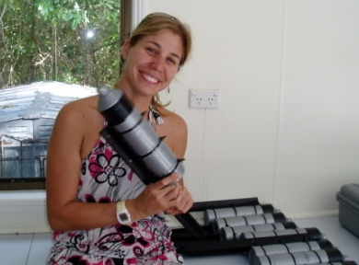
Acknowledgements
Funding
AATAMS (IMOS)
ACRS
Australian Research Council (CoECRS)
Vemco (Amirix) Pty Ltd,
James Cook University (GRS)
Field assistance
J Bathgate, S Bennett, S Blowes, R Bonaldo, R Brooker, P Cowman, C Goatley, A Gonzalez-Cabello, C Lefevre, T Sunderland
Advice and helpful discussions
A Barnett, J Bathgate, D Booth, J H Choat, J Donelson, B Ebner, C Fulton, C Simpfendorfer, T Stieglitz, P Ridd, J Theim, R Vallee, Reef-fish lab colleagues
Project logistics
Staff of OIRS, Rob Gegg, Phil Osmond, J Tanner,
S Wismer

